Slide 1
MUNCH
Progress Report #6
Gabriel Soares & Gabriel Mendonca

Slide 2
Table of Contents
01
02
03
04
Timeline
New Logo
Pipeline System
Evaluations
Notes:
Soares

Slide 3
01
Timeline
Notes:
Soares

Slide 4
Project Timeline
Week 1-2 (Feb 20 - Mar 5)
Finalize Restaurant Search V1.
Setup GitHub and Trello for tasks.
Finalize entire project concept and decide what features the app will have + tech stack to build.
Week 7-8 (Apr 3 - Apr 16)
Finalize Llama search V2 (Review dataset search for better ranking).
Prototype of the overall app for testing.
Integrate Backend and Frontend
Week 3-4 (Mar 6 - Mar 19)
UI/UX Design: Draft initial Figma designs and user flow wireframes.
Optimize restaurant search V1 - Expand filtering capabilities and polish LLM response structure.
Week 9 (Apr 17 - Apr 23)
Finalize frontend development.
Conduct intense testings on the search feature and polish the algorithm/add missing features.
Polish UI and UX designs.
Week 5-6 (Mar 20 - Apr 2)
Finalize development of backend infrastructure.
User authentication implemented.
Basic frontend version working.
Figure out data storing and app hosting
Week 10-11 (Apr 24 - May 1)
Fully ready V1 of the app.
Address any remaining issues or bugs.
Present final project & collect feedback for improvements.
Notes:
Soares

Slide 5
02
New Logo Design

Slide 6


Slide 7
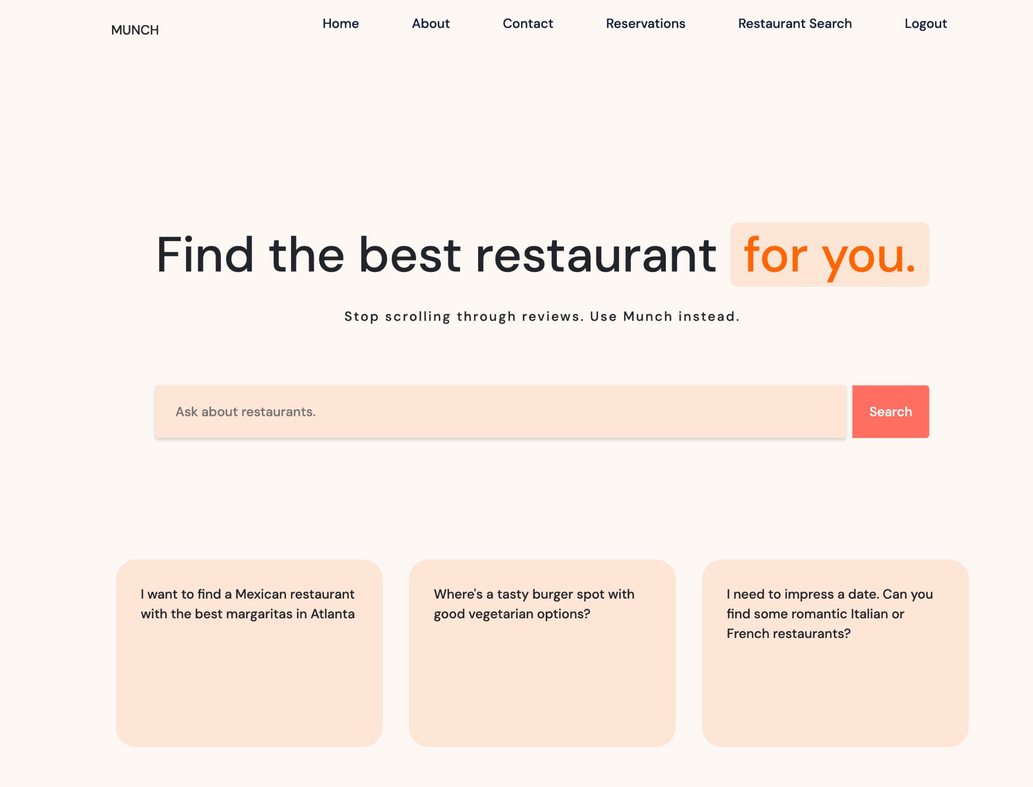


Slide 8
03
System’s
Pipeline

Slide 9


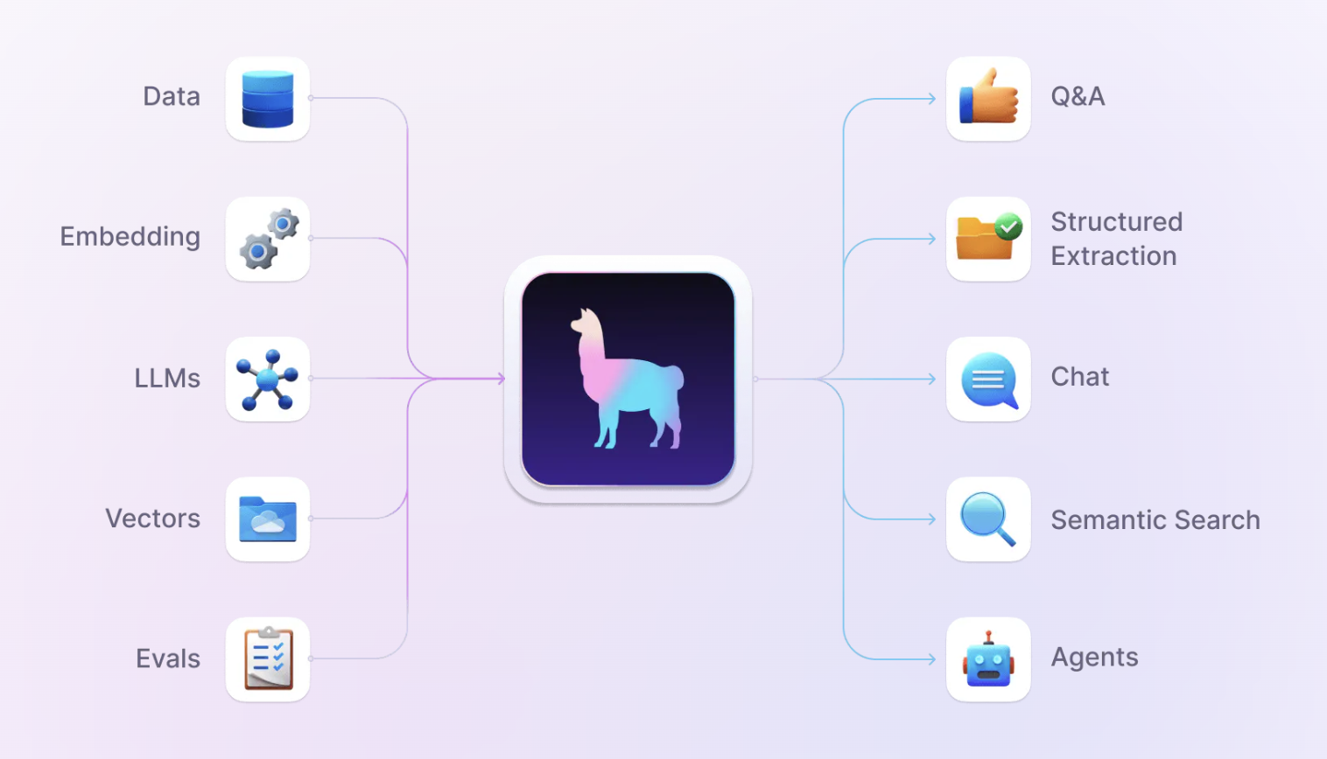
GPT Agent, RAG, and Function Calling
+

Slide 10
Pandas Prompt
Instructing the LLM to generate pandas code for filtering dataset
Database
Database’s schema
Text Query
User’s search query in natural language
2. LLM 1 (AI)
Generates and runs Pandas Code
5. LLM 3 (AI)
Composes final message to the user & populates cards
3. Filtered Restaurant Dataset
Based on hard criteria
4. Reranker
Reranks Remaining restaurants based on the scores for subjective criteria in the enriched dataset
6. Final Results
Displayed in the Frontend in card format
3. Enriched Structured Review Dataset (Created by LLM 2)

Slide 11
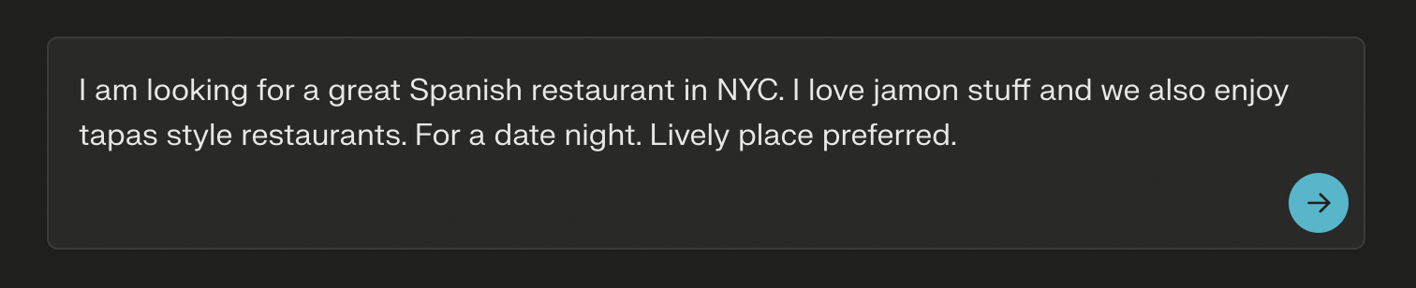
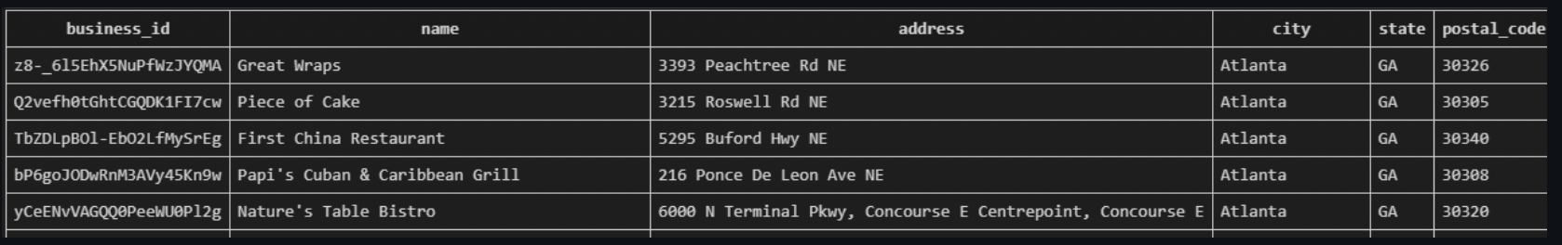
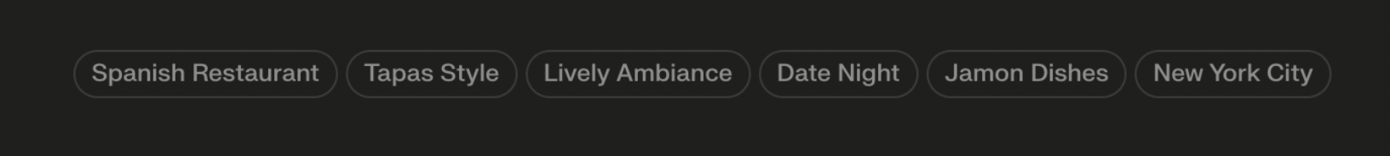
01
Initial Filtering

Slide 12
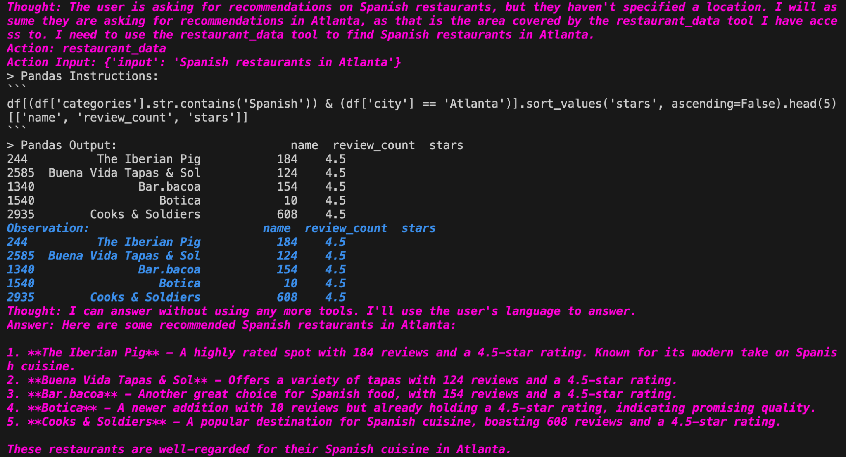
02
LLM 1

Slide 13
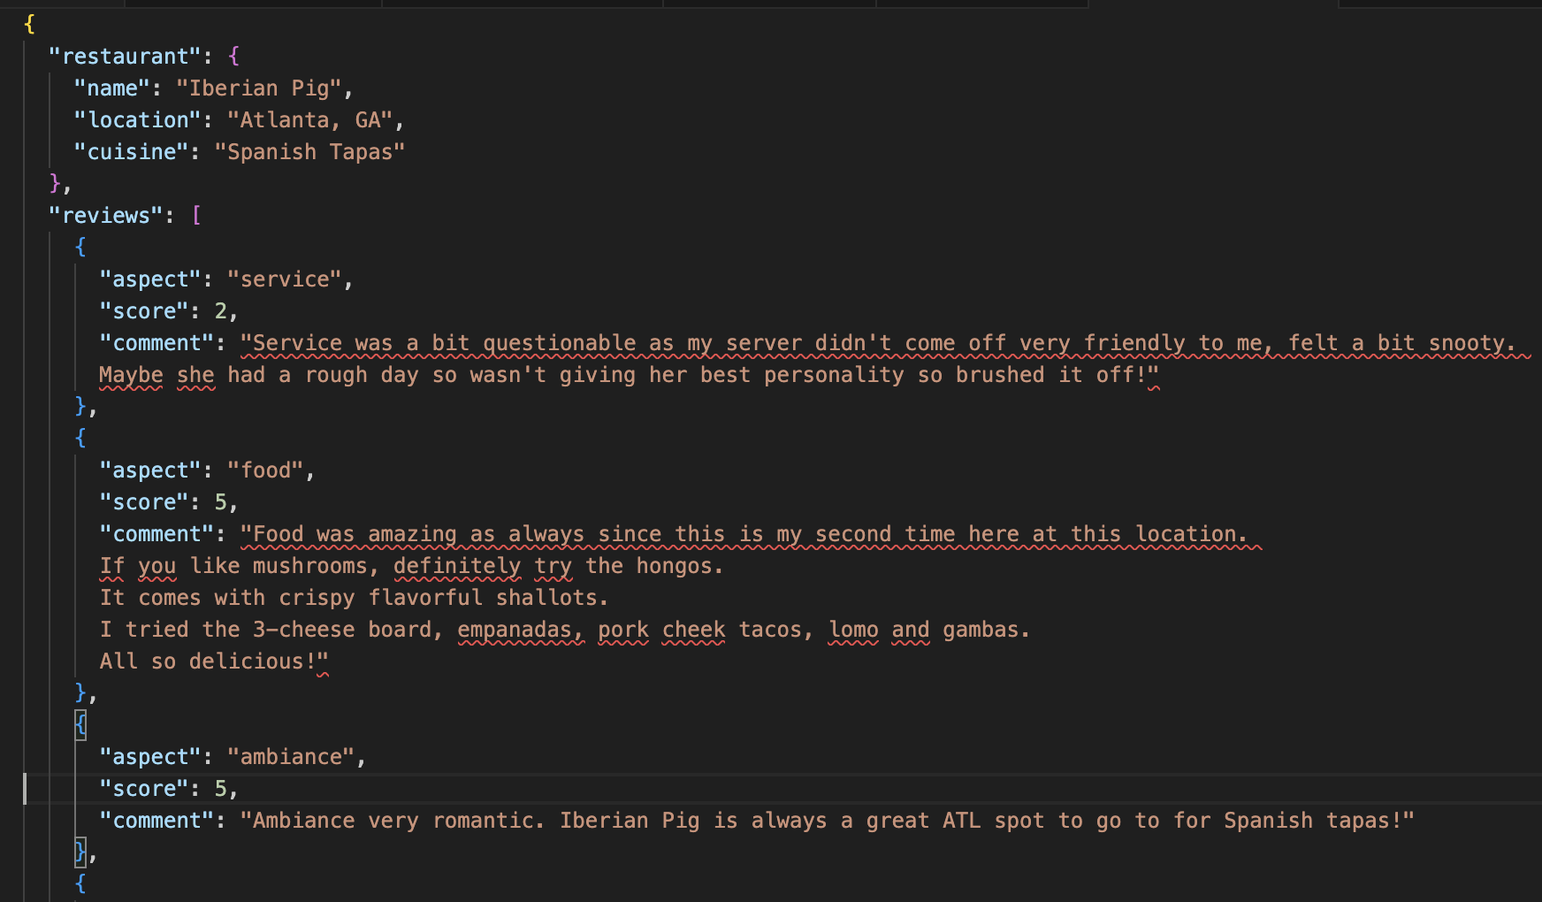
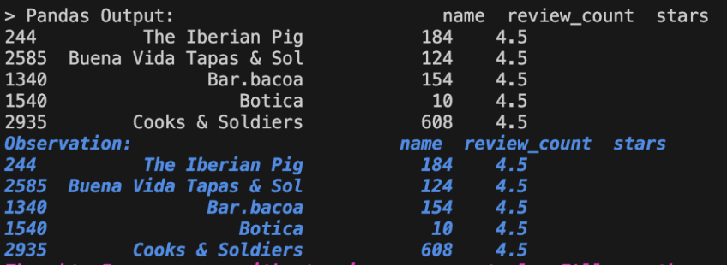
03
System’s Pipeline
Filtered Restaurant Dataset
Based on hard criteria
3. Enriched Structured Review Dataset
Based on subjective criteria

Slide 14
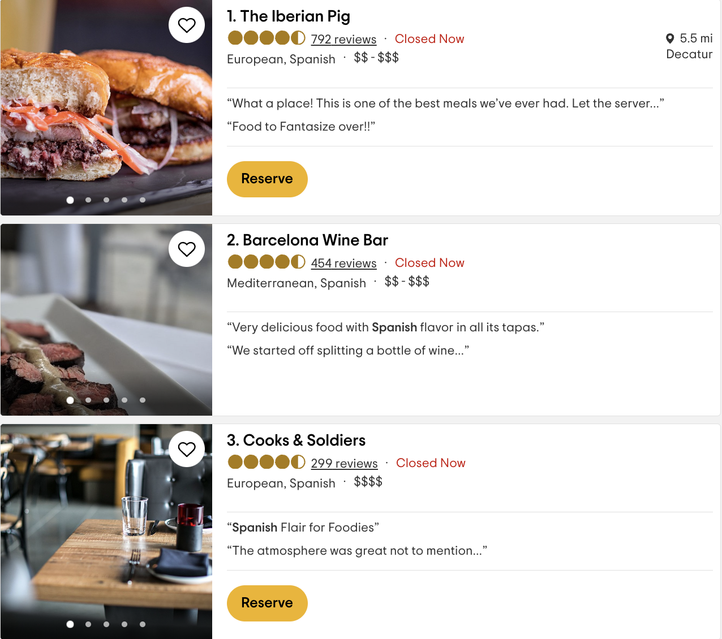
04
Re-Ranker

Slide 15
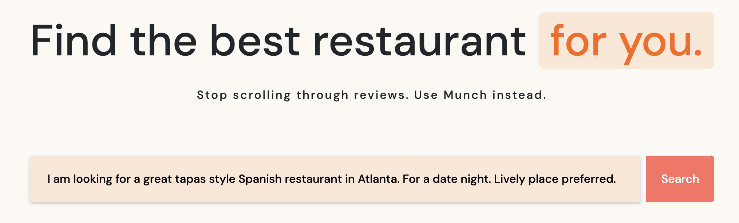
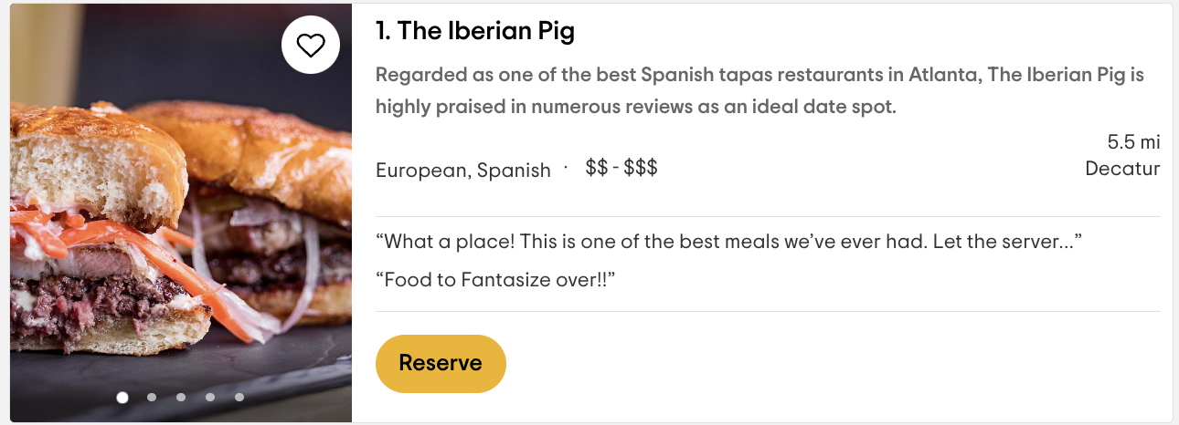

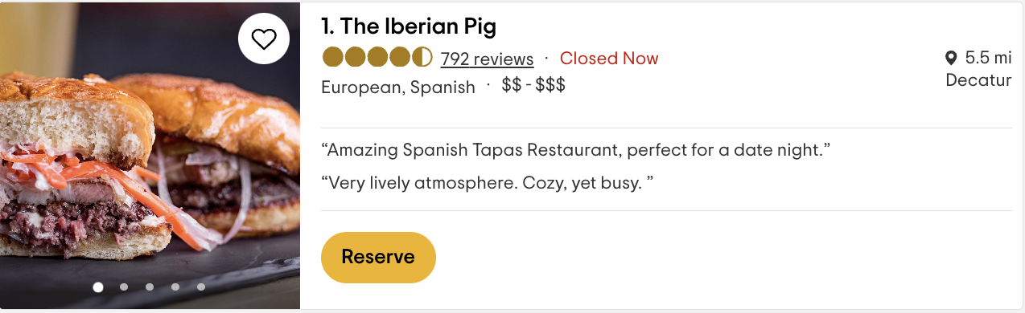

Slide 16
05
Final Results
LLM 2 Generated Text
(To-Do)
Add Our Enriched Scores
Food: 4.8
Service: 4.7
Ambiance: 4.9

Slide 17
04
User Feedback
Plans

Slide 18

User Feedback
Gathering Data
The study will involve a sample size of 10 participants and will primarily focus on evaluating their search experience.
Surveys
We will employ surveys to gather quantitative data and opinions from participants regarding their navigation experiences and preferences.
Compare Competitors
We also intend to conduct a blind user test, where users input different restaurant search queries into both our system, and on competitor’s and compare each other’s responses.

Slide 19
05
Systems Evaluation

Slide 20

Systems Evaluation
Functional Evaluation
Currently working well
Functionality stress testing still causes some bugs (over clicking search button, etc) - Easy fixes
All components of the pipeline are almost all successfully integrated and there are no major bugs in the process
Performance Evaluation
Query to results time: 4.2 seconds on average
Costs per 1000 queries: $0.02
Hosting Costs / Stability: To be tested
Quality Evaluation
Highly reliant on our database and the restaurant reviews
No LLM hallucinations happening
Results are always based on our data
In very rare cases, if we ask for like Spanish restaurants, it might craft the final message to us in Spanish (easy fix)

Slide 21
Thanks!
Questions?

